Slide 1
Time series and Factor Analysis on France covid data
Presented By
Shashank B V

Slide 2
Introduction
In light of the COVID-19 pandemic, governmental and healthcare institutions globally have implemented multifarious strategies to stem the spread of the contagion
The project's outset comprises the scrubbing and manipulation of the dataset to develop daily, weekly, and monthly time seriesPresent inferential methods for forecasting future values of time series data.
The next step involves modeling the time series by implementing classical methods (SES, Holt's, Holt-Winter's) and ARIMA models
this project endeavors to deliver a comprehensive analysis of the COVID-19 testing data in France and contribute to ongoing efforts to contain the pandemic
Notes:
As a result of this class, you will be able to ...

Slide 3

DATA CLEANING AND MANIPULATION
The data contains 300758 observations and 67 variables.
Based on the above fig we can say that there are missing values and we can eliminate them but it may affect the analysis and forecast predictions, so we used interpolation to impute missing values.
Interpolation delineates the process of ascertaining a value from the extant values within a prescribed dataset. An alternate elucidation would be the act of integrating or proffering an intermediary value betwixt two distinct values.
Notes:
As a result of this class, you will be able to ...

Slide 4
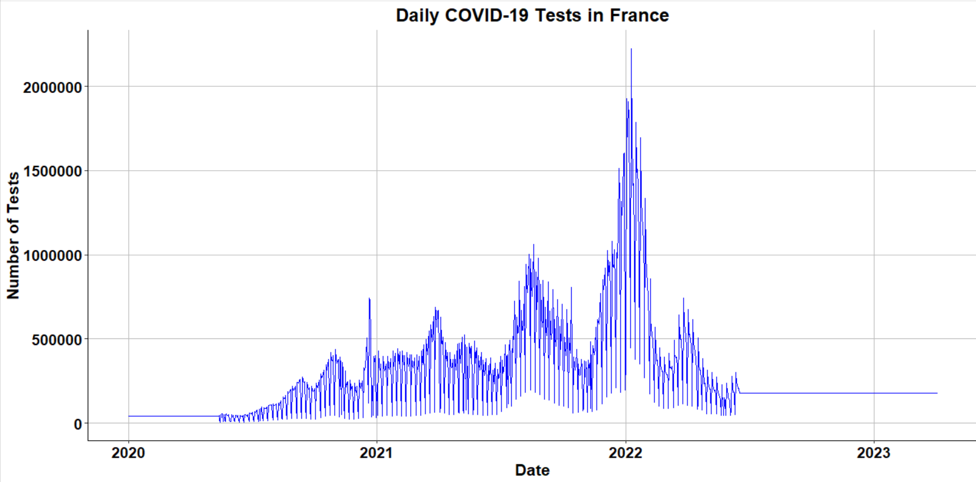
Daily Time series
The Below graph is the time series of daily test performed in France, based on the above graph we can say that no of tests performed in France was significantly high in the year 2022
Notes:
:1, 1, 3

Slide 5
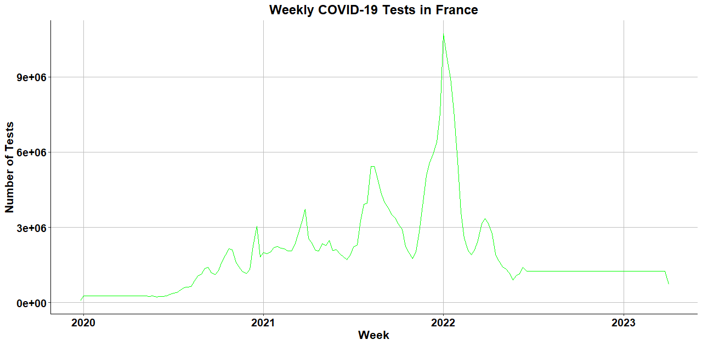
WEEKLY TIME SERIES
In weekly time series we can see clearly in the graph that no of tests performed was high in 2022
This weekly data can be used for analysing trends and patterns, there is no much sufficient data for decision making.
Predicated on the aforementioned précis of weekly time series, the weekly data exhibits a more expansive range compared to the daily data, with test counts fluctuating between 79,112 and 10,709,248 per week. The mean value (1,962,743) surpasses the median (1,255,989), insinuating a positively skewed distribution akin to the daily data.
Notes:
As a result of this class, you will be able to ...

Slide 6
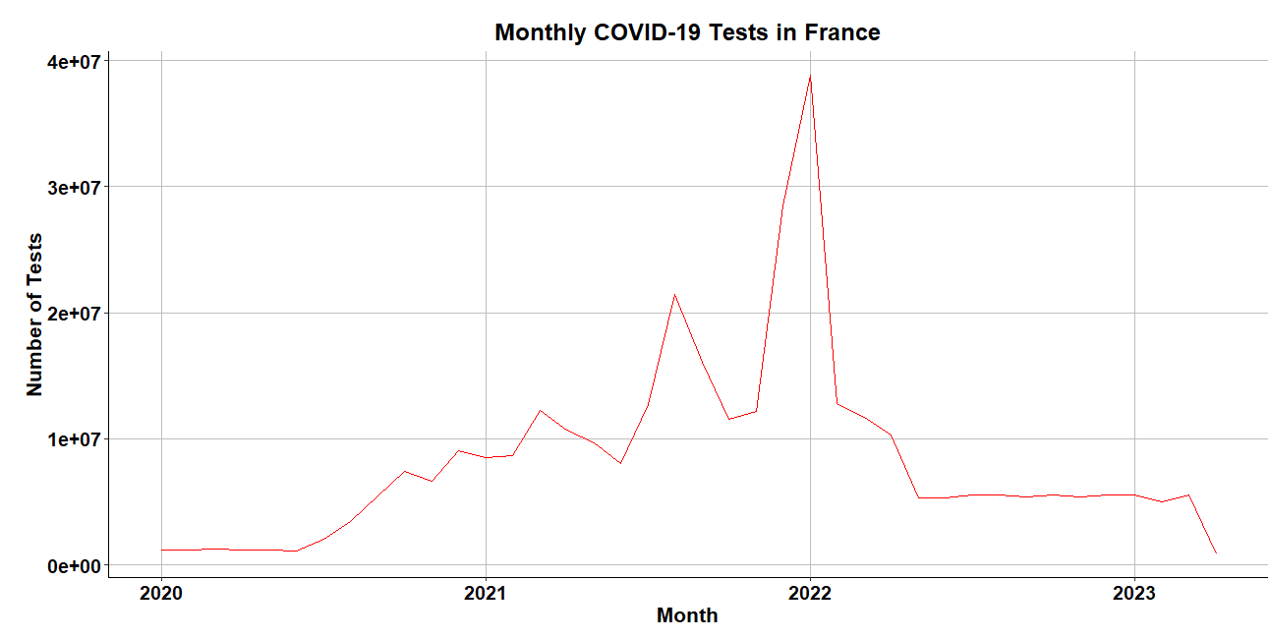
MONTHLY TIME SERIES
This is the monthly time series of the country France, this is as same as the above daily and weekly time series data, the no of tests performed is significantly high in 2022.
The daily, weekly, and monthly time series data of COVID-19 tests performed in France evince positively skewed distributions. This pattern connotes the presence of periods with exceptionally elevated test counts, potentially correlated with discrete events or enhanced testing capacity during the pandemic. The disparities in range and central tendency amongst daily, weekly, and monthly data accentuate the paramountcy of selecting the apposite temporal scale when analyzing and interpreting time series data.
Notes:
As a result of this class, you will be able to ...

Slide 7
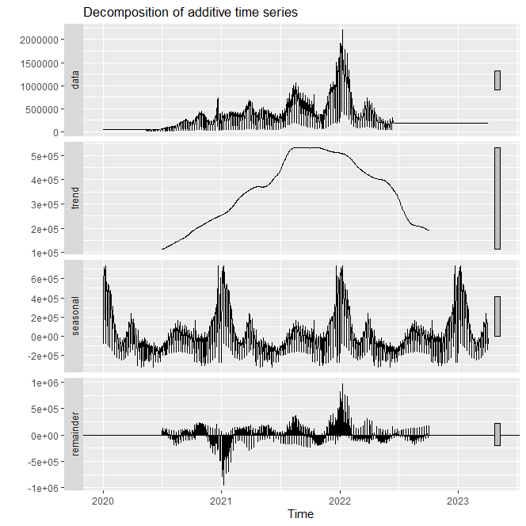
ADDITIVE MODEL FOR TIME SERIES
The expansive range and non-centralization around zero of the additive model residuals insinuate its suboptimal fit to the dataset.
Notes:
As a result of this class, you will be able to ...

Slide 8
MULTIPLICATIVE MODEL
The additive model residuals span from -957,309 to 974,363, while the multiplicative model residuals oscillate between 0.0711 and 1.9434. The latter are not only closer to 1 but also possess a narrower range, indicative of a superior data fit.
The mean residual for the additive model is 8,527, whereas the mean for the multiplicative model is 0.9895, which approximates 1 more closely. Consequently, the multiplicative model is deemed the best fit for the daily time series data.
© 2011 Pearson Education, Inc

Slide 9
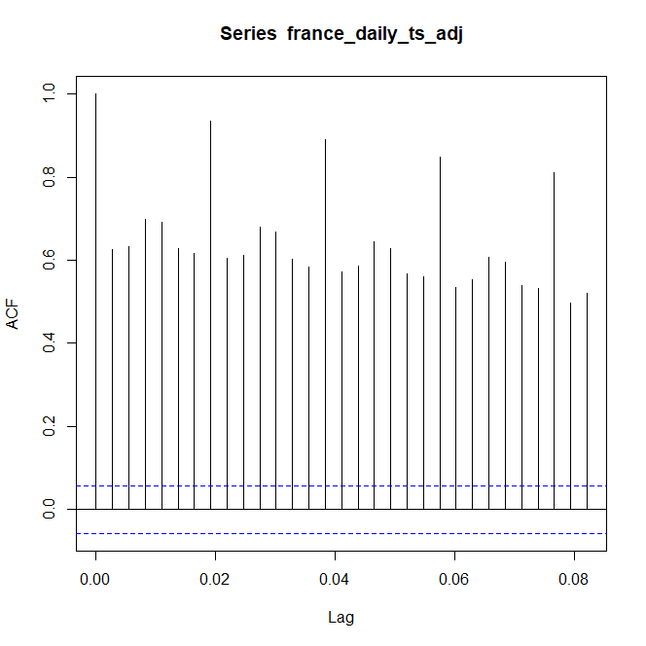
ACF PLOT
The ACF unveils substantial autocorrelations at multiple lags, including elevated values such as 0.626 at lag 1, 0.699 at lag 4, and 0.935 at lag 8. This implies correlations between the time series' current value and past values at disparate lags. Nevertheless, the autocorrelation

Slide 10
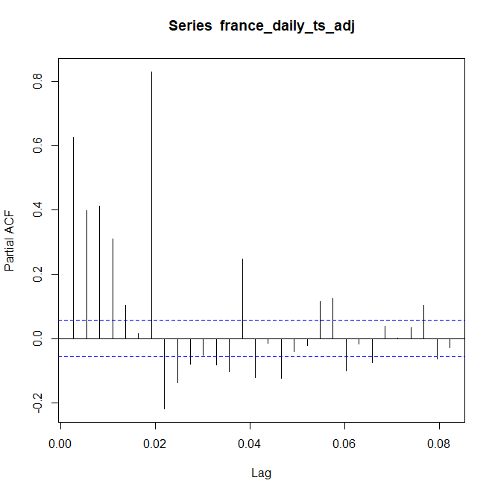
PACF PLOT
The ACF and PACF plots do not exhibit a coherent, recurring pattern of autocorrelations, implying weak periodicity or seasonality. Nonetheless, significant correlations at various lags intimate the existence of underlying patterns in the data, meriting consideration during time series modeling.
Despite the absence of compelling evidence for periodicity, correlations at distinct lags may still influence the modeling and forecasting of the time series. The data does not exhibit potent periodicity; however, the presence of correlations at different lags could affect time series analysis.
© 2011 Pearson Education, Inc

Slide 11
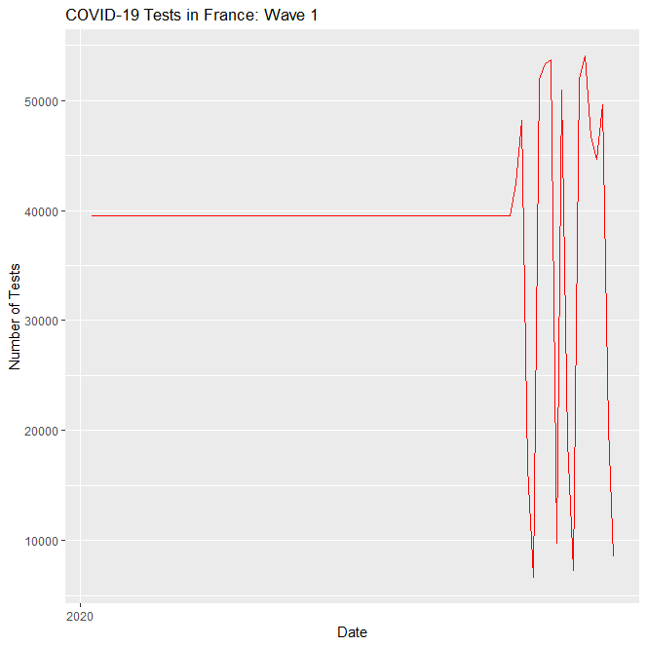
WAV1 TIME SERIES
From the plot, we can see that the daily number of COVID-19 tests performed during the first wave in France gradually increased from March 2020 and reached its peak in early May 2020, followed by a decline in the number of tests towards the end of the wave
© 2011 Pearson Education, Inc
Notes:
Index number for base year will always equal 100

Slide 12
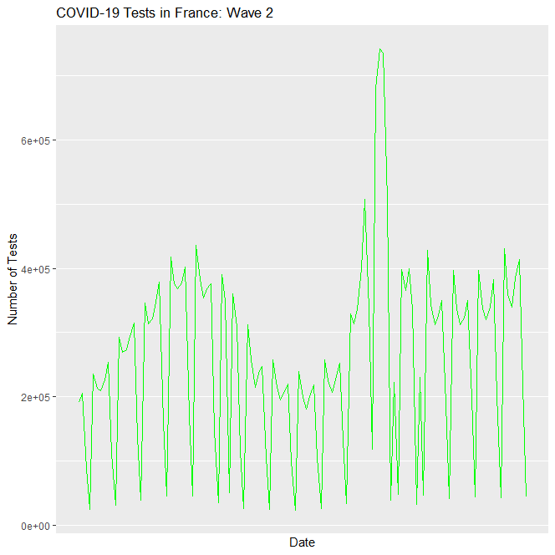
WAVE2 TIME SERIES
The graphical representation elucidates a precipitous surge in tests performed during the second wave commencing in September 2020, reaching its apogee in early November, and subsequently experiencing a gradual decline until the year's end. The second wave's testing frequency generally surpassed the first wave's, with salient spikes in mid-November and early December. The green hue employed in the graph facilitates distinguishing this wave from its counterparts.
The graphical representation elucidates a precipitous surge in tests performed during the second wave commencing in September 2020, reaching its apogee in early November, and subsequently experiencing a gradual decline until the year's end. The second wave's testing frequency generally surpassed the first wave's, with salient spikes in mid-November and early December. The green hue employed in the graph facilitates distinguishing this wave from its counterparts
© 2011 Pearson Education, Inc
Notes:
Index number for base year will always equal 100

Slide 13
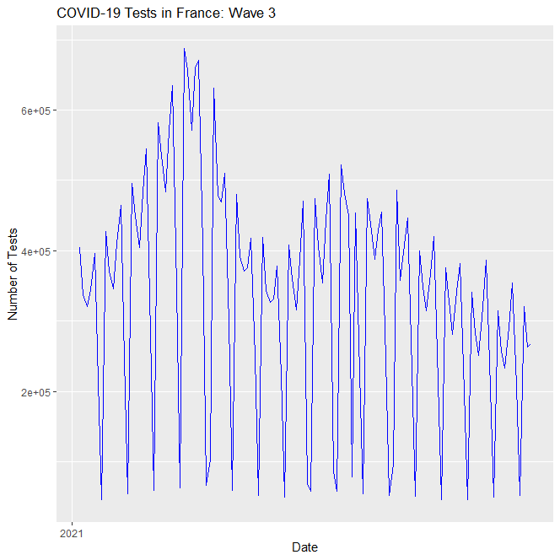
WAVE3 TIME SERIES
The graph illustrates a rapid augmentation in the number of tests conducted in October 2020, peaking in November 2020 before a gradual decline. A conspicuous dip in the test count occurs during the Christmas and New Year festivities, followed by another increase in January 2021, potentially attributable to the emergence of novel viral variants. The third wave's zenith transcends the peaks of the previous two waves, signifying a heightened testing capacity and intensified efforts to curtail viral dissemination.
© 2011 Pearson Education, Inc

Slide 14
TIME SERWAIES MODELLING
Contemplating the daily time series data of France, classical methodologies, encompassing Simple Exponential Smoothing (SES), Holt's Linear Method, Holt-Winters Additive, and Multiplicative methods, shall be employed for all respective waves.
Simple Exponential Smoothing (SES)
Holt's Linear Method expands upon SES
Holt-Winters Additive Method extends Holt's Linear Method
© 2011 Pearson Education, Inc

Slide 15
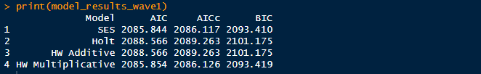
COMAPRING ALL THE METHODS FOR WAVES 1
These outcomes suggest that the Simple Exponential Smoothing (SES) model yields the lowest AIC, AICc, and BIC values for this particular wave, establishing it as the optimal model for this time series data segment. The SES model is deemed most appropriate due to its simplicity and capacity to provide satisfactory data fit without overcomplicating the model. It presumes an absence of trends or seasonality, which might constitute a reasonable assumption for this specific wave.
© 2011 Pearson Education, Inc

Slide 16

COMAPRING ALL THE METHODS FOR WAVES 2
From these results, it appears that the HW Multiplicative model performs the best for Wave 2, as it has the lowest AIC, AICc, and BIC values. This suggests that there is a multiplicative seasonality pattern in the data during this wave. The HW Multiplicative model accounts for both the trend and seasonality components and fits the time series data better than the other models.
© 2011 Pearson Education, Inc

Slide 17

COMAPRING ALL THE METHODS FOR WAVES 3
These findings indicate that the HW Multiplicative model performs optimally for Waves 2 and 3, exhibiting the lowest AIC, AICc, and BIC values, insinuating the presence of a multiplicative seasonality pattern during these waves. The HW Multiplicative model addresses both trend and seasonality components, providing a superior fit for the time series data in comparison to alternative models..
© 2011 Pearson Education, Inc

Slide 18
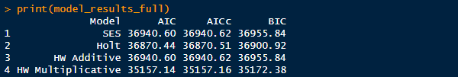
COMAPRING ALL THE METHODS FOR FULL PERIOD
From these results, it appears that the HW Multiplicative model performs the best for the full period, as it has the lowest AIC, AICc, and BIC values. This suggests that there is a multiplicative seasonality pattern in the data for the entire time series. The HW Multiplicative model accounts for both the trend and seasonality components and fits the time series data better than the other models.
The Holt-Winters Multiplicative model prevails as the superior choice, addressing both trend and seasonality components via a multiplicative relationship, outperforming alternative models in data fitting. This suggests that seasonal fluctuations alter proportionally with the series' level, rendering the multiplicative model more befitting for the data.
© 2011 Pearson Education, Inc

Slide 19
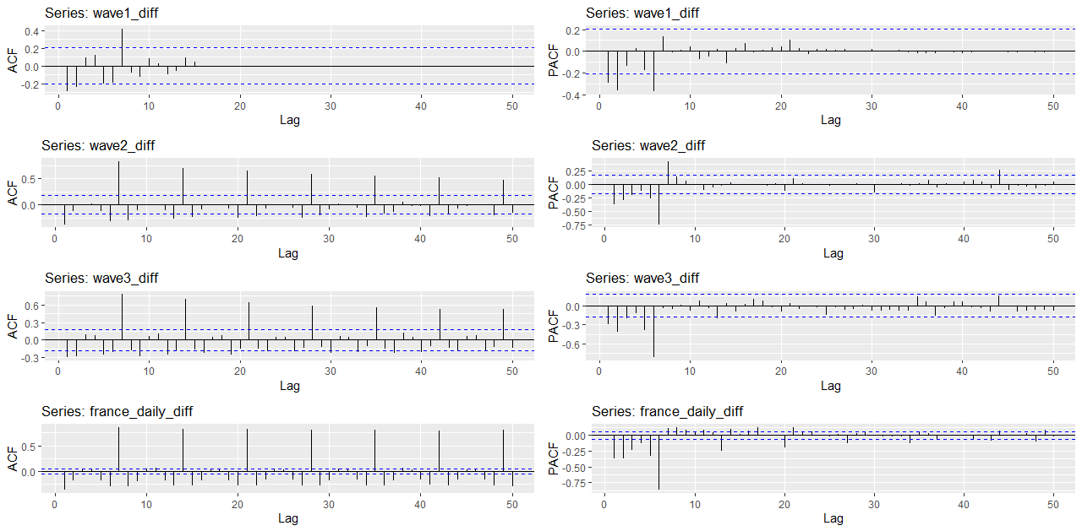
CORRELOGRAMS
These observations suggest a shared pattern across all three waves and the full period, with data displaying significant autocorrelations at lags 1, 2, 5, 6, and 7. This intimates that an autoregressive (AR) model with a lag order of at least 7 might be apt for modeling daily COVID-19 cases in France. Nevertheless, executing further diagnostic tests and model selection criteria (such as AIC or BIC) is crucial to pinpoint the most appropriate model for this dataset.
© 2011 Pearson Education, Inc

Slide 20
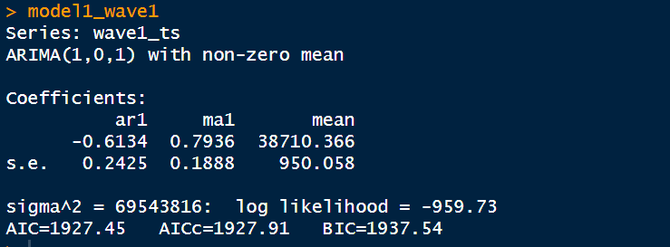
MODEL1 (WAVE1)
An ARIMA (1, 0, 1) model is tailored to wave1_ts, encompassing an autoregressive component of first order, an undifferentiated component of null order, and a moving average constituent of first order.
© 2011 Pearson Education, Inc

Slide 21
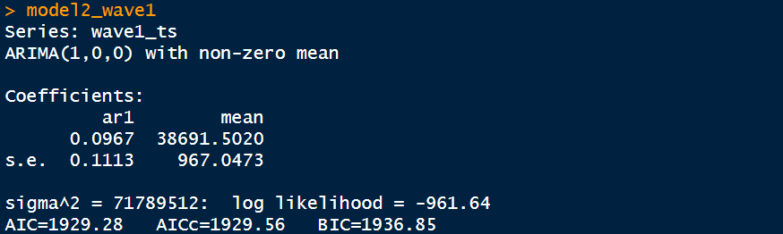
MODEL 2 (WAVE2)
An ARIMA (1, 0, 0) model, bespoke to wave1_ts, incorporates an autoregressive constituent of first order, devoid of differentiation and moving average components.
The residuals for Model 2 (Wave 1) are all identical, indicating that the model is not a good fit for the data.
© 2011 Pearson Education, Inc

Slide 22
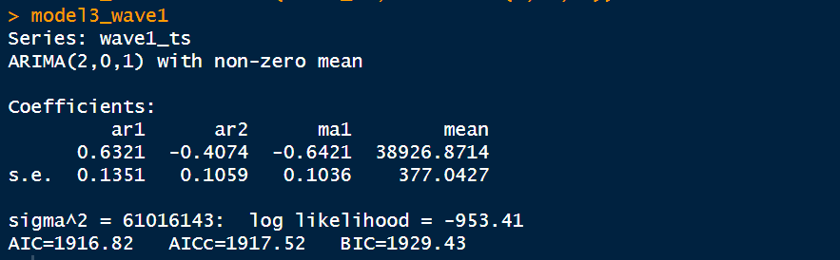
MODEL 3 (WAVE1)
An ARIMA (2, 0, 1) model, adapted to wave1_ts, features an autoregressive element of second order, eschews differentiation, and includes a moving average component of first order..
© 2011 Pearson Education, Inc

Slide 23
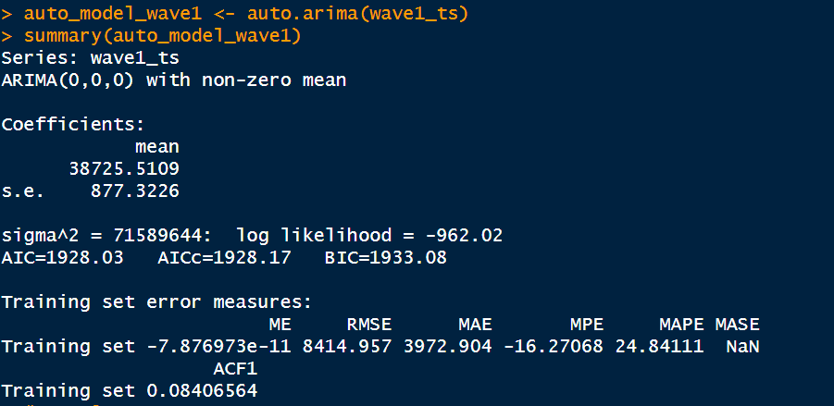
AUTO ARIMA MODEL FOR WAVE 1
For wave1, the auto.arima function selects an ARIMA(0, 0, 0) paradigm with non-zero mean. The Akaike Information Criterion (AIC) for this model stands at 1928.03, accompanied by relatively minuscule training set error measurements. However, this rudimentary model neglects potential patterns or seasonality in the data.
© 2011 Pearson Education, Inc

Slide 24
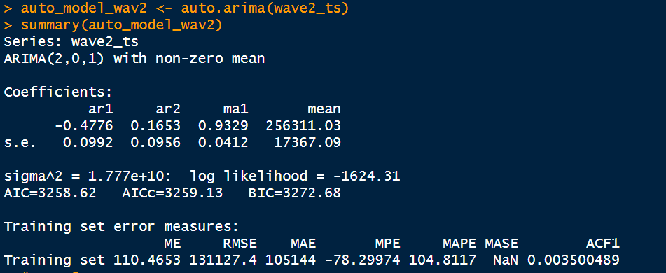
AUTO ARIMA MODEL F0R WAVE 2
For wave2, the auto.arima function opts for an ARIMA(2, 0, 1) model with non-zero mean. The AIC for this model, 3258.62, surpasses that of the wave1 model. While training set error measurements exceed those of wave1, this intricate model accounts for potential data patterns.
© 2011 Pearson Education, Inc

Slide 25
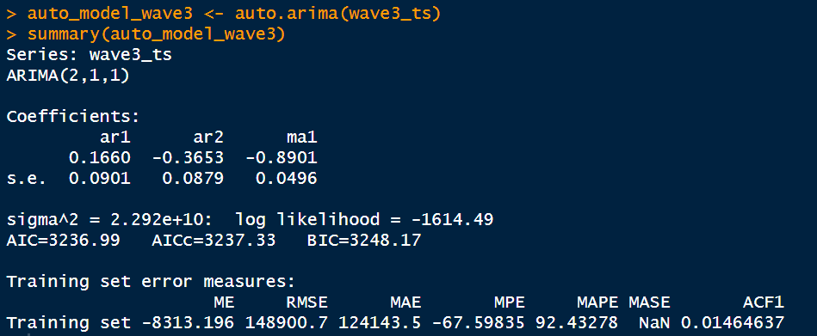
AUTO ARIMA MODEL F0R WAVE 3
For wave3, the auto.arima function elects an ARIMA(2, 1, 1) model. This model's AIC, 3236.99, bears resemblance to the wave2 model. Despite higher training set error measurements compared to wave1, this model accommodates the first-order difference in the data.
Classical ARIMA models hold sway over the dataset, as they address both trend and seasonality of the time series, with model3_wave1 claiming the crown.
© 2011 Pearson Education, Inc

Slide 26
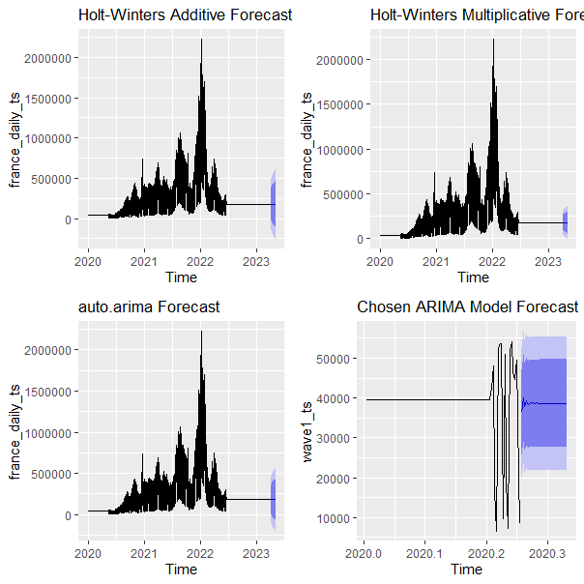
FORECASTING
Holt-Winters Additive Forecast:
The additive seasonal decomposition of time series data underpins this method. The forecast materializes as a tabulation of point forecasts and confidence intervals (80% and 95%). Point forecasts denote predicted values, whilst confidence intervals delineate the range wherein true values are anticipated to reside with 80% and 95% confidence, respectively.
Holt-Winters Multiplicative Forecast:
Analogous to the additive method, this approach employs multiplicative seasonal decomposition of the time series data. The forecast manifests as a table, enumerating point forecasts and confidence intervals (80% and 95%).
Auto ARIMA Forecast:
This technique autonomously elects the most congruous ARIMA model for the time series data. The forecast is depicted as a table, enumerating point forecasts and confidence intervals (80% and 95%).
Chosen ARIMA Model Forecast:
This forecast, contingent on the designated ARIMA model (user-specified or predicated on model diagnostics), is portrayed as a table with point forecasts and confidence intervals (80% and 95%).
© 2011 Pearson Education, Inc

Slide 27
CONCLUSION
Upon looking at the mean absolute error (MAE) for each forecasting method, able to assess the accuracy of the models. The MAE measures the average absolute contrast between the anticipated and actual observed values for a given period, with lower MAE values indicating better predictive accuracy.
otThe MAE values for the Holt-Winters Additive and Multiplicative models are generally near, but the Additive model includes a slightly lower MAE, proposing that it is imperceptibly more precise than the Multiplicative model.
In general, the auto.arima model is the top-performing model among the four models evaluated in estimating the final periods of the time series based on these results.
© 2011 Pearson Education, Inc

